Slide 1
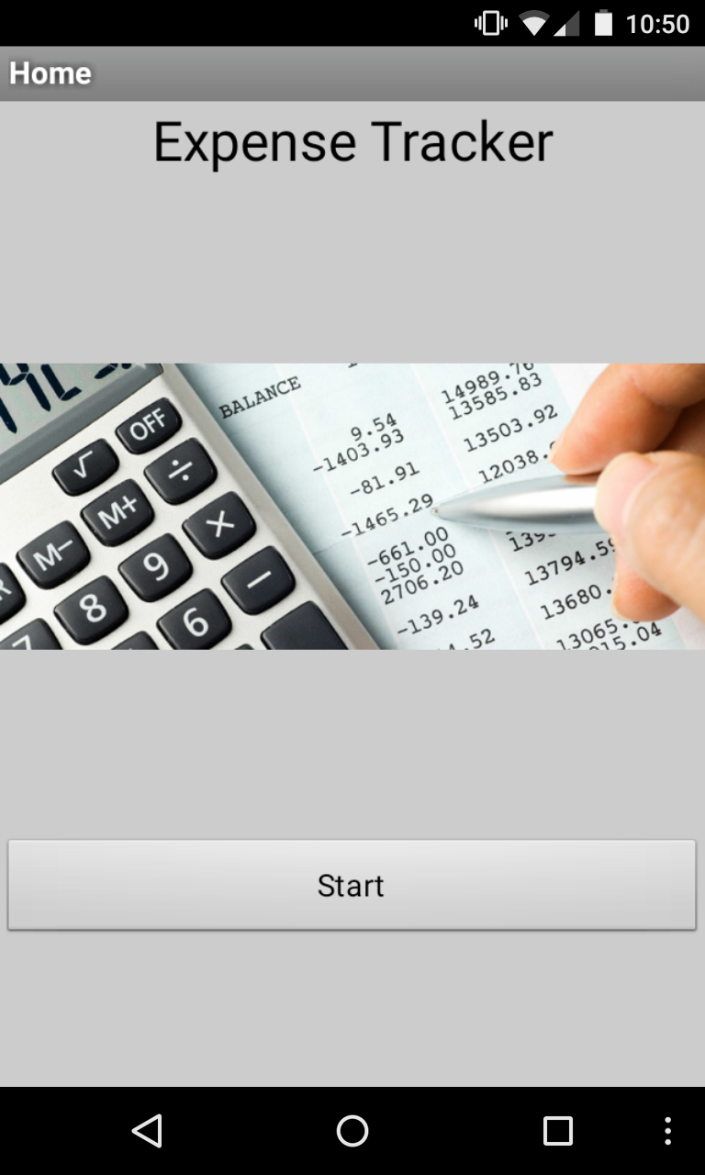
Expense Tracker
Android Mobile Application

Slide 2
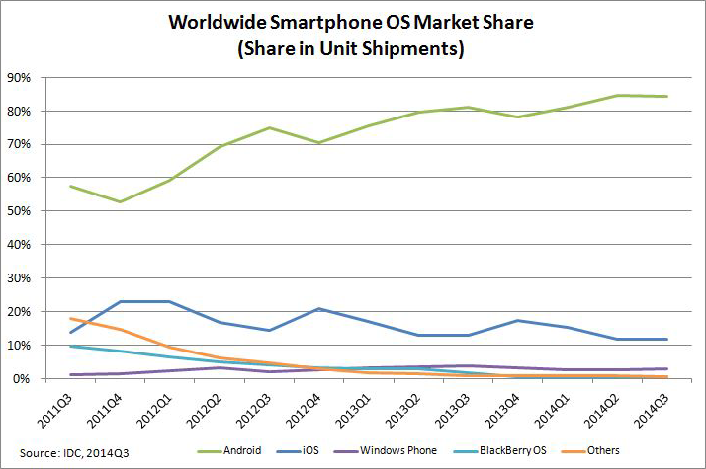
Android Market Share
“Android shipments lead the global smartphone market, with 283 million units shipped and over 84% of the market share in the third quarter of 2014.” (International Data Corporation (IDC), Q3 2014).

Slide 3
Expense Tracker
Expense Tracker is a mobile application for mobile devices with Android OS. The App assists users keep track of their day-to-day expenses. Users can manage their incomes, expenses, and review their balances at any time.
The app was built using a tool provided by Google. The tool is called “App Inventor” and can be used by simply logging into the App Inventor page using a Google account.

Slide 4
Home Screen
Label
Screen1: The first screen in Expense Tracker
Image
Button

Slide 5
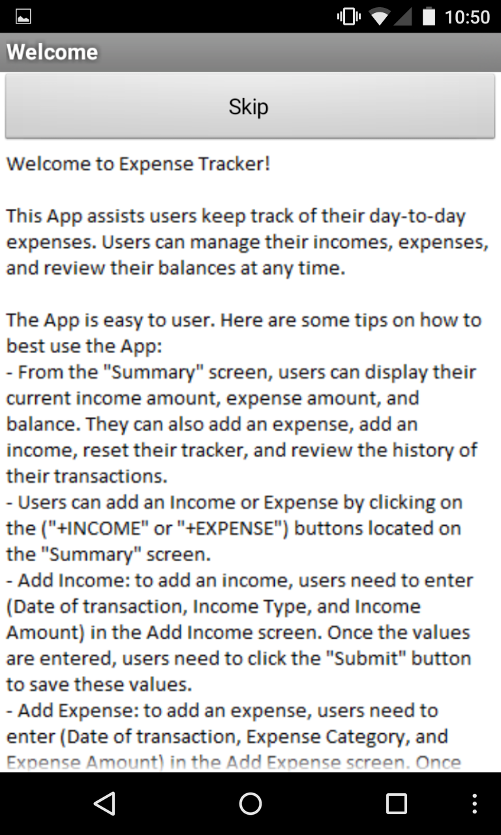
Welcome Screen
Button
The “Welcome” screen is to welcome the user and give some tips on how to use the App.
Image
Button

Slide 6
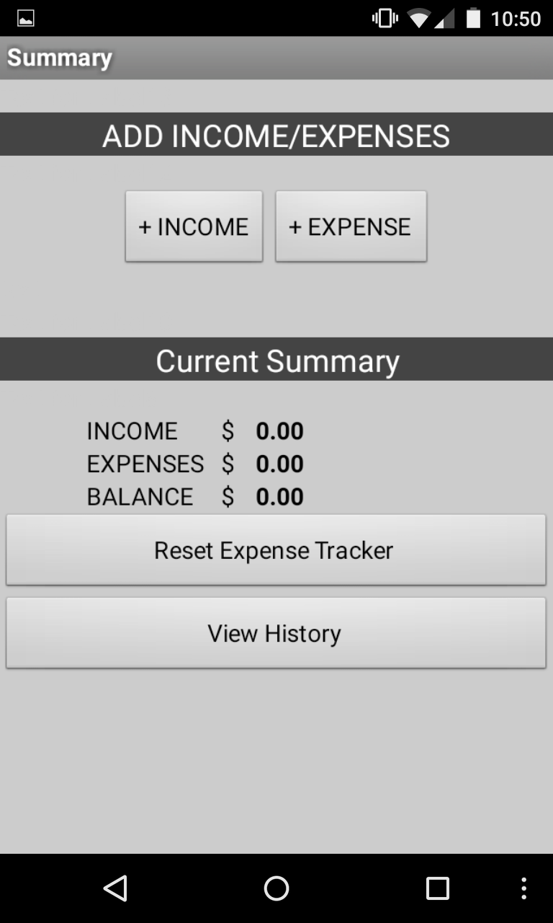
Summary Screen
Label
The “Summary” screen is the main screen of Expense Tracker. It displays the results of all inputs done via the app.
Horizontal Arrangement
Label
Table Arrangement
Button
Button

Slide 7
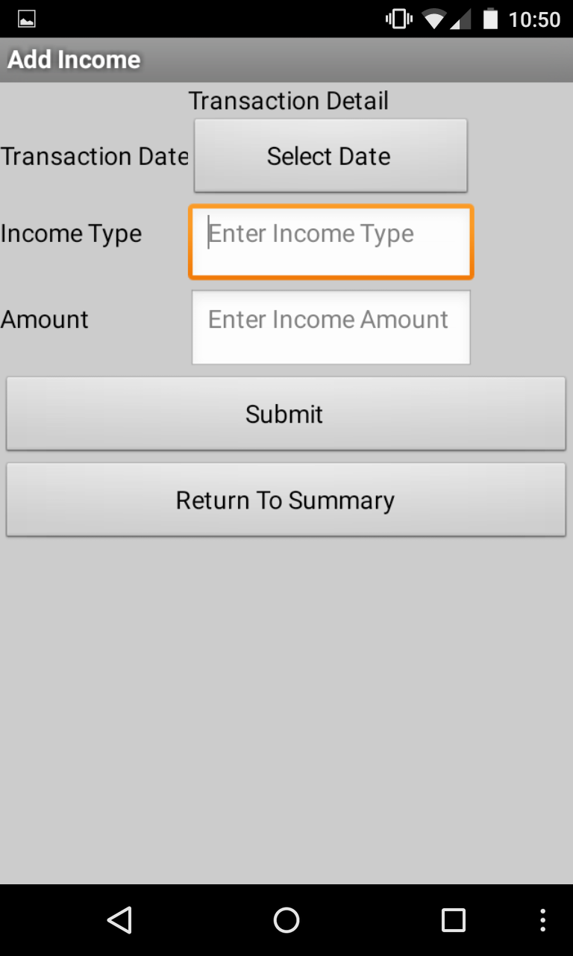
Add Income Screen
Label
This is where the user enters any income type. The transaction can enter whenever the user receives an income- Daily, weekly, monthly, etc.
Table Arrangement
Button
Button

Slide 8
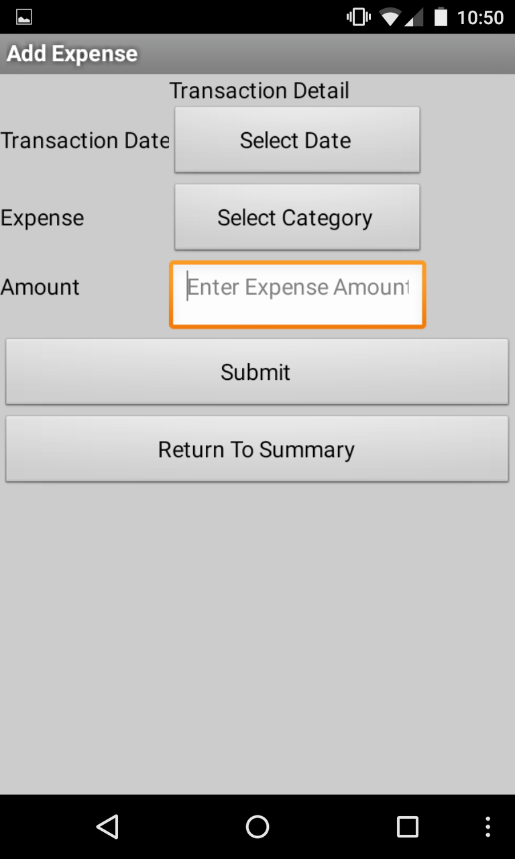
Add Expense Screen
Label
This is where the user enters any expense type. The transaction can enter whenever the user receives an income- Daily, weekly, monthly, etc.
Table Arrangement
Button
Button

Slide 9
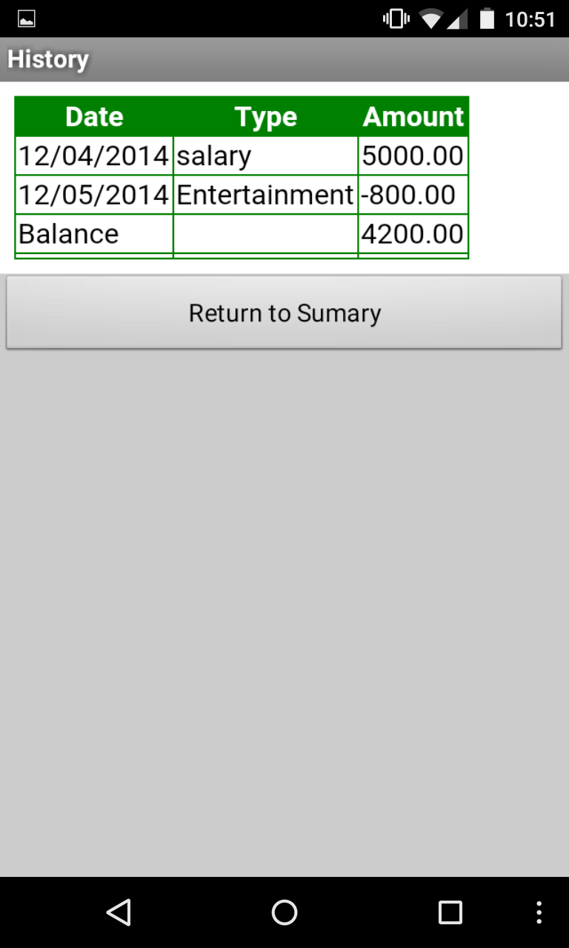
History Screen
The “History” screen displays or transactions done up to date. If the “Reset” button is pressed, the history is cleared.
Web Viewer
Button

Slide 10
Thank You!
Ahmad Atiyah

